Slide 1

Analysis of Twitter Data

Slide 2

Problem Statement
After a year-and-a-half long hiatus, many offices are opening. Most companies are asking that employees return on a hybrid basis, meaning they come into the office at least some of the time. But what exactly that will look like is uncertain.
Hence, to understand people's view on whether they are comfortable with Work from home or want to come back to offices , I considered analyzing the worldwide twitter data.
This project aims to study #workfromhome and #remotework related tweets to find out the opinions expressed by people.
Notes:
Even though many companies allowed their staff to work remotely before the COVID-19 pandemic hit the world, it became the new norm after that. As the pandemic spread, forcing the world to go into lockdown, business organizations were left with no other option than to switch to online working. As a result, there has been a drastic increase in the number of remote workers, lately.
Since the begining of pandemic,to address the people's eagerness and to express their views, the trend of people has moved very fast towards social media platforms. Twitter has emerged as one of the most popular platforms among those.

Slide 3
Data
The data was collected by reading through Twitter API on from July 11,2021 to July 26,2021.
Most recent and popular tweets from #workfromhome and #remotework were taken to conduct the analysis.
Below features were extracted from twitter :
1. Text of the tweet
2. User location
3. Date and Time the tweet was posted
4. Unique Id of the tweets
Total Tweets | Number of tweets that had both hashtags | Actual Tweets | Number of Retweets
22054 | 17381 | 14483 | 7571

Slide 4
Most Retweeted Tweets
'RT @IanLJones98: A four-day week could change the #FutureofWork v/@wef #RemoteWork #HybridWork #AI #IoT #5G cc @DrJDrooghaag @FrRonconi @Ni…'
'RT @HaroldSinnott: What will the Future of #Jobs look like?\n\nvia @wef\nhttps://t.co/H3d7u88IWn\n\n#FutureofWork #HybridWork #DigitalTransforma…'
'RT @HathorNetwork: #Hiring - We are looking for a Head of #Design to join Hathor Network and Labs to guide the #creative department in-hous…'
'RT @kreminil: I am happy how the home office has become. This way I can be productive, while also just chill. Lots of screen to use.”
'RT @stratorob: Limiting our work and focusing is the only way we’re gonna get to the point of doing high-quality work.\n\n#RemoteWork #Sunday…'

Slide 5
Most Retweeted Tweets
Dash is looking to hire a Senior Software Engineer 🔥 • Remote Anywhere • Apply now to be among the first candidates 👇 #javascript #blockchain #tendermint #techjobs #softwaredevelopment #remotejobs #workfromhome #GoRemote https://t.co/VSh91dFfGu
🔥 New Remote Jobs: – Brand Experience Designer ➔ https://t.co/qkdqvPA02C – Python Developer ➔ https://t.co/YyGwHJesJN – Customer Success Manager ➔ https://t.co/TsQ2QlXRE9 – Full-Stack Software Engineer ➔ https://t.co/r00lprMxU0 #RemoteWork #Designer #Python #FullStack
AhoyConnect is hiring remote for the following roles: 👉 Customer Success Manager 👉 Backend (Ruby) Engineer Apply now 👇 https://t.co/nz5CSRl2u4 #remotework #remotejobs
👋 Nira is hiring remotely for a Software Engineer 🧰 Distributed Systems | Big Data | 100% Remote. #RemoteJob #RemoteWork #BackendDeveloper Apply now! 👇 https://t.co/MELGsgwwpQ🧰-distributed-systems-big-data-100-remote-760897
We’re looking for people to #JoinTheHerd! #RemoteWork positions available: Senior Software Engineer (full-stack), Platform Solutions: Remote https://t.co/mjduknX7dS

Slide 6
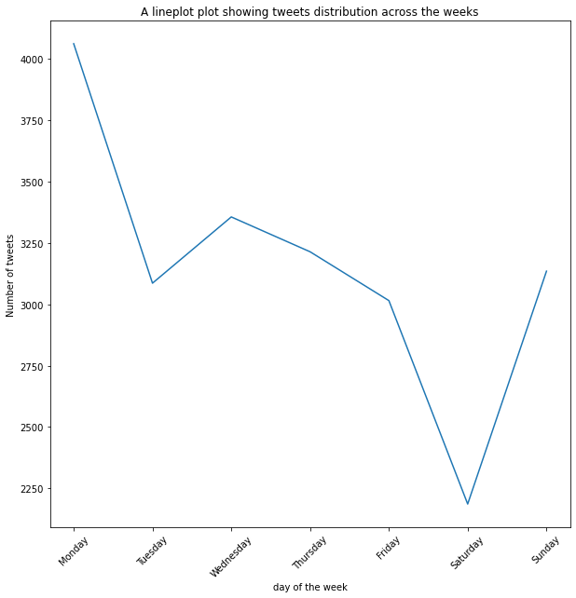

Tweets distribution on weekdays
Lowest tweeting activity on Saturday, then the frequency increases slowly up to Monday where the max is recorded

Slide 7
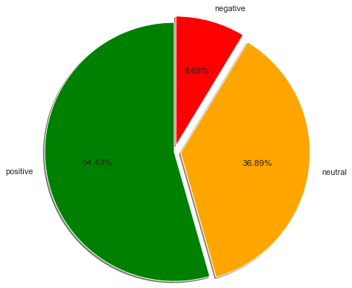
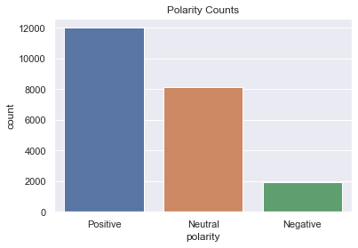
Polarity of the data
12000 tweets were interpreted as ‘Positive’
8000 tweets were interpreted as ‘Neutral’
2000 tweets were interpreted as ‘Negative’

Slide 8
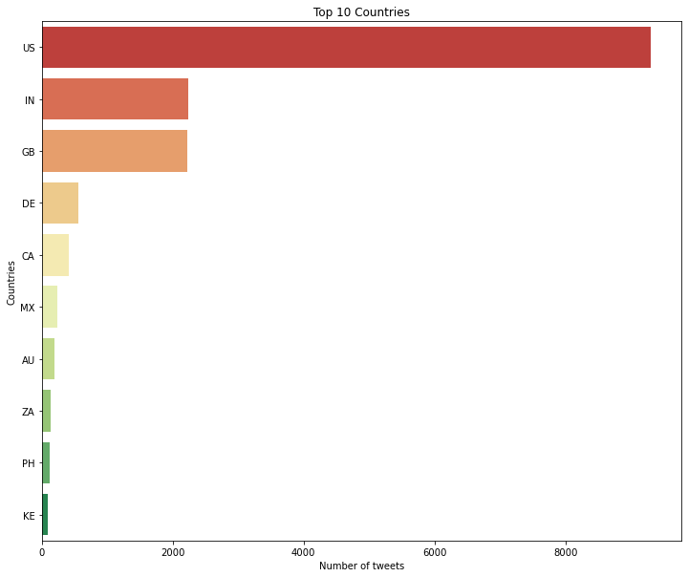
Most tweeted 10 countries
According to Sysomos research, Top 10 countries, number of Twitter users: USA, UK, Canada, Australia, Brazil, Germany, Netherlands, France, India, South Africa.

Slide 9
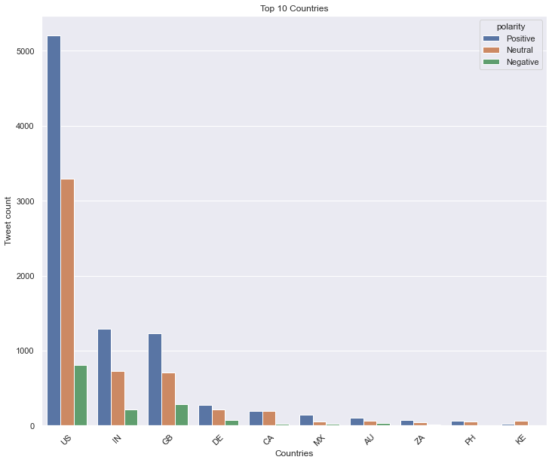
Number of positive,neutral and negative tweets in most tweeted 10 countries

Slide 10
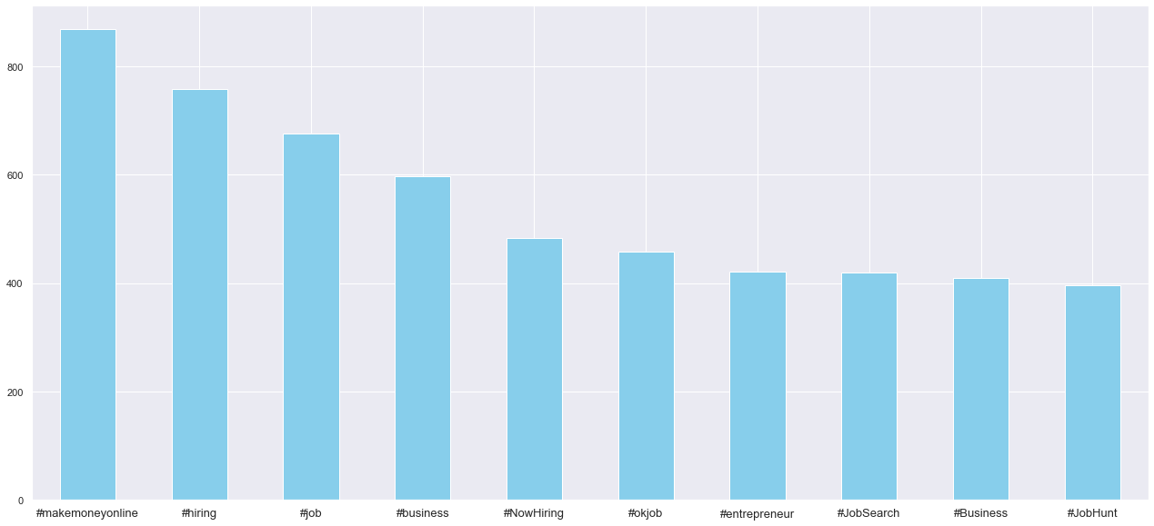
Most repetitive hashtags
Hashtags used in most of the data apart from #remotework and #workfromhome are mostly about remote jobs.

Slide 11
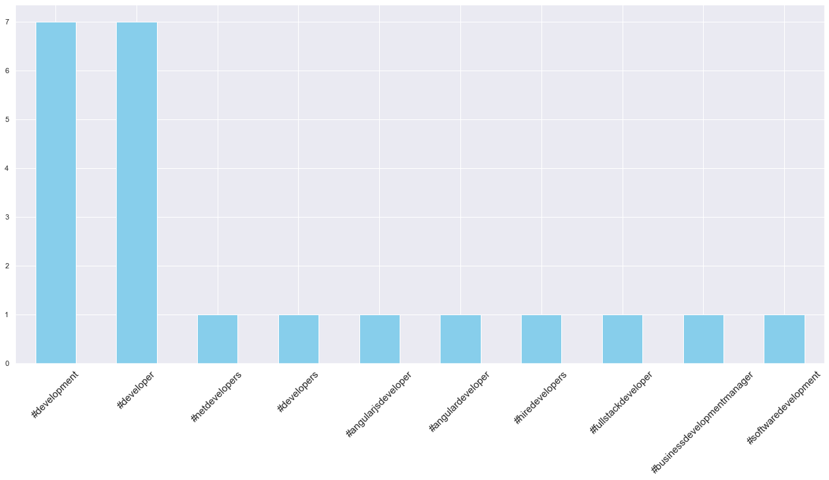
Cluster 0
Dash is looking to hire a Senior Software Engineer 🔥 • Remote Anywhere • Apply now to be among the first candidates 👇 #javascript #blockchain #tendermint #techjobs #softwaredevelopment #remotejobs #workfromhome #GoRemote https://t.co/VSh91dFfGu
🔥 New Remote Jobs: – Brand Experience Designer ➔ https://t.co/qkdqvPA02C – Python Developer ➔ https://t.co/YyGwHJesJN – Customer Success Manager ➔ https://t.co/TsQ2QlXRE9 – Full-Stack Software Engineer ➔ https://t.co/r00lprMxU0 #RemoteWork #Designer #Python #FullStack
AhoyConnect is hiring remote for the following roles: 👉 Customer Success Manager 👉 Backend (Ruby) Engineer Apply now 👇 https://t.co/nz5CSRl2u4 #remotework #remotejobs
👋 Nira is hiring remotely for a Software Engineer 🧰 Distributed Systems | Big Data | 100% Remote. #RemoteJob #RemoteWork #BackendDeveloper Apply now! 👇 https://t.co/MELGsgwwpQ🧰-distributed-systems-big-data-100-remote-760897
We’re looking for people to #JoinTheHerd! #RemoteWork positions available: Senior Software Engineer (full-stack), Platform Solutions: Remote https://t.co/mjduknX7dS

Slide 12
Cluster 0
Description | US | UK | Canada | Japan | India | Switzerland | Philippines | Norway
Job openings for 'python developer' | 7 | 6 |  | 1
Job openings for ‘director' level | 7
Job openings for 'data analyst | 9 | 1 | 1
Job openings for 'cloud infrastructure engineer' | 17 | 1 | 2 |  | 1 | 1 | 1
Job openings for 'full stack developer' | 42 | 2 | 1 | 1 |  |  |  | 1
Job openings for 'product manager | 8 | 1
Job openings for ‘architect' level | 2
Job opening for ‘dotnet developer' | 1
Job openings for 'block chain developer' | 20

Slide 13
Cluster 1
The past year has proven many small businesses can operate from home. But there are still ways you can improve employee productivity and collaboration within the context of your remote or hybrid work strategy. Read here: https://t.co/qEdUhMoNP0 #remotework https://t.co/2QXmXzInyL
Working from home is the best alternative during the COVID-19 pandemic. A virtual office is a good solution to ensure your business continues to run effectively. Call us now for further information 0131 221 6500 #virtualservices #virtualassistant #PA #entrepreneur #workfromhome https://t.co/MEFnH57HD2
What are your rights if you’d rather work from home for good, or at least adopt a half-and-half hybrid system? 💻📱 Citizens Advice has answered the need-to-know questions &gt; https://t.co/mFOaj3MjGR #LifeAfterLockdown #WorkFromHome #HealthAndSafety #Wellbeing https://t.co/jyU8FT4NwT
For many office workers #COVID19 has radically changed how and where we work. In the absence of face-to-face meeting knowledge workers need new collaborative tools to safely access the data they need to do their jobs https://t.co/cBBWzXtigI. #WorkFromHome #DataGovernance
Working at home doesn't mean your work environment should look unprofessional. Keep our virtual meeting ground rules in mind on your next video call, and visit our site for more tips. https://t.co/lR8EACxVoj #virtualmeeting #videocalls #businessgrowth #remotework https://t.co/WGbSQzQn1A

Slide 14
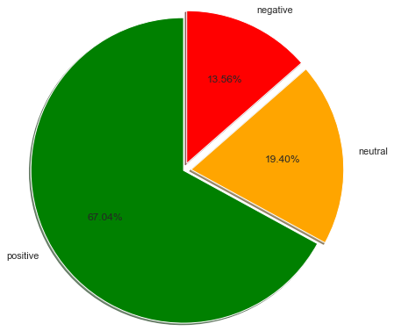
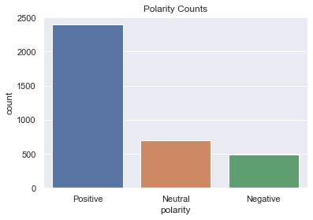
Polarity of the Cluster 1 data

Slide 15
Work-life Balance
"Someone said yesterday, now work-life(life revolving around work) balance has changed to life-work(work revolving around life) balance due to remote work, and I couldn't agree more.\n#remotework"
'Do you know #RemoteWorkers are likely to be more productive with their job, &amp; have a healthier work-life balance with less distraction? \n#Technavio believes in safety of employees &amp; hassle-free remote work opportunities by creating #WorkFromHome company policies. #WorkLifeBalance https://t.co/Nf2jNeTZUi'
'How to improve work-life balance during #WFH? \n\n👉Set a proper working #hours \n👉Take a quick #break. \n👉Eat and sleep on #Time \n👉Make a #fitness routine \n👉Plan post-workday #activities \n\n#Sapper #support #remotework #coronavirus #employees #work #motivation #Wellbeing https://t.co/T76eP6caGS'
'Covid-19 pandemic proved that #remotework is #functional in multiple ways from work-life #balance to job #efficiency. There is an untalked perspective of this phenomenon as well: #GenderDivide! Do you think the ratings are different between the genders? https://t.co/AqZ1rmbPe4'
Mental Health
'I should have the right to not respond to work emails at 11pm on a Monday. That time is for me. #Manager - please use the schedule feature. It looks like a little clock. \n#WorkFromHome #WorkLifeBalance #Mentalhealth'
'Mental health got worse during the pandemic as people tried to maintain a healthy work-life balance.\n\nBeing a professor himself, @jaiminism talks about the issues he faces with #WorkFromHome\n\n“I feel like an ATM (any time mazdoor) who has to attend meetings at any point of time"'
'Need to make time for wellness? Click here for 7 wellness tips for working from home that prioritize your emotional health. #Wellness #MentalHealth #EmotionalWellness #WorkFromHome @WorkAtHome https://t.co/Z6FgI3gQSH'
'How to not burn out while taking on challenging problems - \n1. Take 5 min break after every hour\n2. Find a hobby that you enjoy apar from work or profession like read fiction\n3. Exercise everyday\n4. Sleep at least 6 hours a day\n#Mentalhealth #WorkFromHome'
'Businesses all over the world have been forced to stop shop and establish a #WorkFromHome culture due to the #pandemic. That, if not carried out in the right way, could do more harm than good. Here are 7 tips to maintain your #MentalHealth while #WFH.\nhttps://t.co/KXsQ7C2bA8'
Notes:
how mental health has been effected post pandemic,tips to maintain mental health.
tips to maintain work life balance,impact of work from home on work life balance

Slide 16
Survey on preference
"Working from home has become a #newnormal for many Canadians. To better understand how they feel about #remotework after over a year of working from home, we asked them. Check out Canadians' work-from-home preferences. #futureofwork #workingfromhome https://t.co/aqHnrt1rPy"
'With so many still working from home, which image best summarises your experience? Tidy, designated workspace, working from the sofa, or having to juggle work and family life? Vote A, B or C!\n\n#workingfromhome #workfromhome #homeoffice #flexibleworking #newnormal #homeworking https://t.co/PQo9ZVcVxE'
'Recently, a new survey focusing on federal employees indicated that they lean towards "a more flexible future work environment." These setups are definitely here to stay, @Frank_Konkel. Thanks for this! #RemoteWork #Productivity https://t.co/ZH1wra6ySh'
'What are employees saying about the future of remote work? Find few highlights from the recent survey. \n-\n-\n-\n #remotework #workfromhome #remoteworking #digitalnomad #covid #wfh #coworking #business #entrepreneur #homeoffice #freelancer #freelance #remotejobs #workfromanywhere https://t.co/H533KeIR5m'
"In Digital's recent survey, nearly half of business owners say #RemoteWork is hurting productivity. @Inc discusses what this means for employers and employees as the #pandemic comes to an end.\xa0https://t.co/jQ3fIqpZHx https://t.co/QHJ8qJ7Ol9"
Future of work
'The last 18 months have forever changed the way we work. Some have thrived, many have closed, and remote work is finally becoming commonplace.\n\u2060\nWhat changes are happening at your workplace, and how will it impact your organization?\n\n#worklifebalance #remotework #futureofwork https://t.co/ihPcBSwwKs'
'Work from Anywhere (WFA). It’s our new normal 😃 Thanks to @alisachoi for this snapshot of her remote office view! Read more on how the pandemic has change the future of work: https://t.co/EqE2GfxJwJ\n\n#workfromhome #remoteworklife #workfromanywhere https://t.co/vbuYpvpNPa'
'For some people #WorkFromHome has been a blessing but others have struggled; so does the future of work look hybrid? Hear more from the #iWellness experts here 👉 https://t.co/2vg4Fc0aa4 https://t.co/njadt6WBCy'
Notes:
survey on users experience with work from home,users preference on work model,what users think future of workplace will look like
how pandemic changed future of work

Slide 17
‘Apple
'Apple will require employees to return to the office three days a week starting in September, but staffers are unhappy with the inflexible manner of this arrangement.\n\n📧 Subscribe: https://t.co/MYc0D5YvOi\n\n#workplace #flexibility #remotework #hybridwork \n\nhttps://t.co/6srAT69epX'
"Apple is forcing some disabled employees back to the office, even though they've been cleared to stay WFH under the Americans with Disabilities Act. Great reporting from @Hamilbug via @BusinessInsider \n\n#DisabilityTwitter #RemoteWork #FutureOfWork\n\nhttps://t.co/2U7gSSSYyg"
'#Employees, as per the report, have been talking about getting @Apple attention on the matter. In June, employees conducted an internal survey and more tan 35% weren’t comfortable with Apple’s #hybridworkmodel.\n\n#EmployeeExperience #remotework \n\nhttps://t.co/qN1dKbqSZ4'
"It has been reported that many Apple staff are quitting in response to that company's 'hard-line' approach to #RemoteWork. Given that Apple has allowed staff to work at home three days a work (i.e., #HybridWork), is this a sign of things to come? \n\nhttps://t.co/edzByDYcAS"
'Apple employees sent a second letter to CEO @tim_cook and retail and people chief Deirdre O’Brien about the proposed return to the office. #remotework #WFH \nhttps://t.co/MbiUHaBj9d'
‘Hybrid Work
'‘Hybrid’ is the word of the moment for office work but the hybrid work model as it seems to be currently envisaged, is just not going to work https://t.co/UjOtlMbUkd #remotework #remotejobs #business #remoteworking #workingfromhome #staysafe #HybridWorkforce #FutureOfWork https://t.co/W4BVKLKCal'
'"Total remote work is often not realistic or practical, but employers can attract talent by offering some form of hybrid work flexibility" @rickgrimaldi15 via @hrdive #HR #HRleadership #RemoteWork #HybridWork #FutureOfWork #EmployeeX https://t.co/MsvHgCnVIt'
'85% of working adults in the UK are in favour of continuing with hybrid working, even after a move back to the office (ONS, June 2021) \n\nAre you ready to be back in the office or are you hoping to stay seated at your #WFH set up?\n\n#freedomdayUK #WorkFromHome'
Notes:
Apple's recent decision to open offices by September and the respone from employees on this decision.
hybrid work flexibility,preference on hybrid work,challenges with hybrid work

Slide 18
Opinions
"I used to hate working from home but now that I've got my little office area set up in the outbuilding, I much prefer it. #WorkFromHome \n\nBeats having to go on public transport and dealing with the windowlickers and #COVIDIOTS. #FreeDumbDay"
'Because people are working from home, many "issues" are neatly avoided - racism, sexism, transgender, homophobia, baldness, disability, halitosis, dandruff, bad hair days, LGBTQAnon whatever. Home is liberating us from dealing with those other weirdos #WorkFromHome'
"Someone just mentioned that they hate working from home because they don't get to do potlucks. Umm good. Potlucks suck. I don't even like socializing much less being forced to bring food when I don't want to carry around a giant dish. #WorkFromHome is awesome."

Slide 19
Cluster 2
The perfect #accentchair for your #office! Now, meet and greet your clients in the comfort of #NaomiHome Marisa Top Grain Genuine Leather Mid-Century #Chair. Shop Now - https://t.co/249Zsga5Zh #OfficeFurniture #workspace #workstation #workfromhome #homeoffice #chairsbyNaomiHome https://t.co/Y8BlfakYEC
Gig economy to boost employment of Indian women in formal sector: UNDP report #UNDP #IndianWomenInFormalSector #Ficci #Covid19 #GigEconomyToBoostEmployment #UnitedNationsDevelopmentProgramme #WorkFromHome https://t.co/3fIRQE1DIK
Up Now 07.13.21 Vehicle Pricing Madness – Word to Buyers &amp; Sellers / Supplements &amp; Herbal Remedies – A Warning. https://t.co/h4p5CrnUdc via @AJBCSurveys #paid #workfromhome
Impressed with Sabio, Mike took a chance and now he has a lucrative #career as a #SoftwareEngineer. Sound appealing? https://t.co/Oo6NVe5yOM #CodingBootcamp #LearntoCode #Tech #Home #Work #WorkFromHome #Coding #100DaysOfCode #CodeNewbie #Programming #CSS #Programmer https://t.co/WbI2wlcZob
Friday commute to the writing barn #workfromhome #friday #barnlife #countryliving @ Loudoun County, Virginia https://t.co/9l5VT1nHJe
Notes:
.

Slide 20
Cluster 2
Description | US | UK | Singapore | Thailand
Job openings for Nurse , Teacher , Content Moderator |  | 13
Job opening for project manager with SaaS/mobile background | 1
Job openings for teacher | 1
Offers to buy office chairs | 5
Offers to buy office desks | 4
Rise of covid cases |  |  |  | 1
Marketing their masks |  | 1 | 1

Slide 21
Cluster 3
We’re growing our team! We have open roles in Product, Marketing, Sales, Technology and Finance! If you want to make a difference at a growing tech company, find your future here! https://t.co/zibSjm2U0j #remotework #hiring #techjobs
🏅Today’s featured article looks at the remote work skills you can include on your CV to help you gain a hiring managers attention. 🆓 Sign up for FREE to read the article and more: https://t.co/SW14gXK5xW #jobsearch #wfh #worklife #careers #CV #remotework #remoteworking https://t.co/0WQL3WytJN
Remote work is a spectrum. Learn what it takes to create a great remote culture at your company. Save 50% on the Remote Work Master Class: https://t.co/mi2cgC73R2 Now includes free companion Kindle book. #remotework #remoteworking
Whether you’ve had a remote sales team for a while or have recently made the shift to remote work, make team engagement an integral part of your company culture. Here are 20 simple ways to keep your remote sales team engaged. https://t.co/qF1E1P1yot #sales #remotework https://t.co/OkbqOzrnz4
To help business leaders when it comes to managing remote workers, we have listed some ways that can be considered for better remote management of teams and individuals. #Tips #remotework #remotejob #employees #WorkFromHome #management #teams #EmployeeEngagement #Leaders #codleo https://t.co/6ZBtIGZcld

Slide 22
Cluster 3
# of Tweets | Description | US | UK | Canada | India | Kenya | Mexico | South Africa | Spain | UAE
100 | Job openings Sales/Salesforce/B2B Sales | 44 | 19 | 5 | 5 | 5 | 5 | 3 | 1 | 1
53 | Job openings as Customer Service Representative/Advisor | 34 | 1
# of Tweets | Description
39 | software tools to enhance work from home experience, work productivity tools to boost productivity.
85 | technology trends /trends of work model, the reasons it will stay
127 | tips on how to negotiate remote salary, managing long-term remotework, interview remote team candidates, remote project management.

Slide 23
Next Steps
To conduct an online survey on remote work and use the survey results along with twitter data to analyze people's views.
Collect large sample of twitter data.

Slide 24


